Slide 1
Lockheed Martin I2S Subcontract Management Portal(SMP) Access Instructions
Last updated January 29, 2026

Slide 2
System Overview
Housed outside the LM firewalls, it offers a secure method for suppliers / subcontractors to submit Unique Item Identification (UID) and Government Furnished Property (GFP) information to Lockheed Martin and automatically load the information into I2S for submittal to the IUID Registry.
LM
Gateway Exchange
(GWX)
Input file sent to GWX
I2S Subcontract Management Portal
Input file sent to I2S
Item Identification System
(I2S)
Audit file returned to GWX
Audit file emailed to Supplier and LM I2S Administrators
Suppliers
LM I2S Administrator
LM Firewall

Slide 3
How Does the Portal Help?
Allows suppliers / subcontractors to submit UID and GFP information to Lockheed Martin and automatically load the information into I2S for submittal to the IUID Registry
Reduces LM manual labor for validating and verifying data from subcontractors
Audit files are emailed back to the supplier and to the LM administrators upon submission, allowing for timely feedback on successful submissions and failures
Records the supplier POC information for each UID to allow traceability back to the submitter

Slide 4
Accessing the Subcontract Management Portal
To align with Lockheed Martin's Enterprise security standards, the I2S Subcontractor Management Portal (SMP) now requires AccessLM authentication to gain access for external users. AccessLM will be using the Enterprise's robust and proven method of providing authentication.
The process now requires two steps for gaining access to upload UID records.
1. AccessLM Account
External users are now required to have an AccessLM account containing a Microsoft credential. Users will need to contact the Supplier Integration team request a sponsor invitation for AccessLM.
Aero: supplier-integration.gr-aero@lmco.com
MFC: Supplier.Onboarding.1LMX@lmco.com
2. Request SMP Access
Once your AccessLM account is created and you have the Microsoft credential, the next step is to use the link below and follow the steps on this presentation to submit an access request to our UID Supplier portal (SMP) where you will upload the UID records.
Lockheed Martin I2S Subcontractor Management Portal (lmco.com)

Slide 5
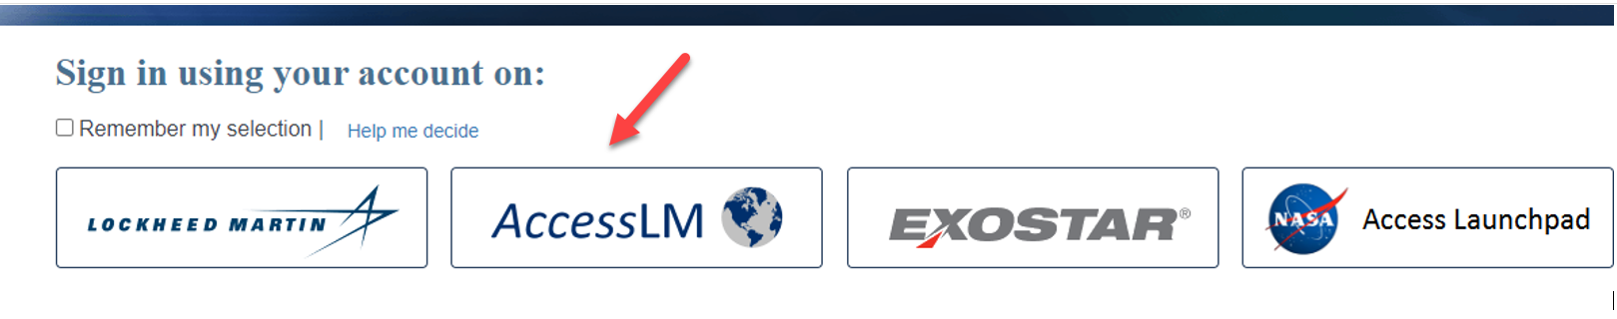
Accessing the Subcontract Management Portal
Use an Internet browser to navigate to the Portal’s log in page: https://lmsupplieruid.external.lmco.com/
Select the AccessLM option below

Slide 6
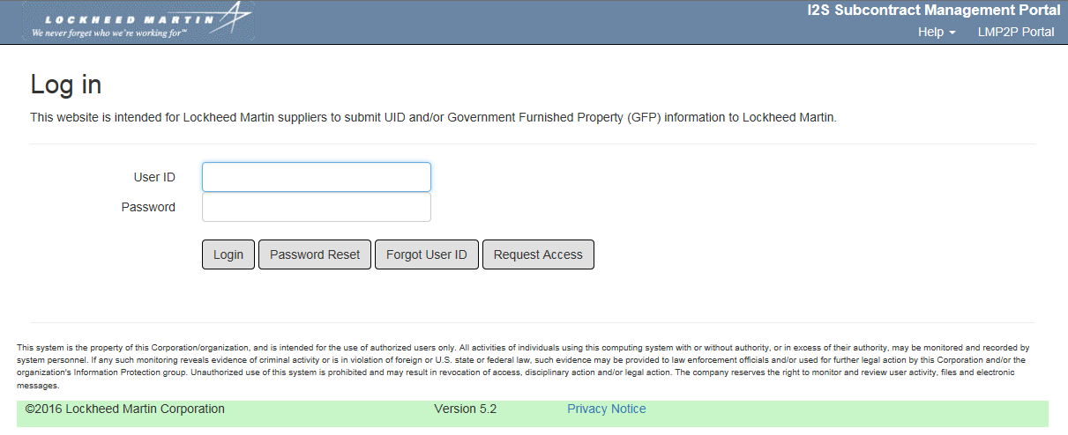
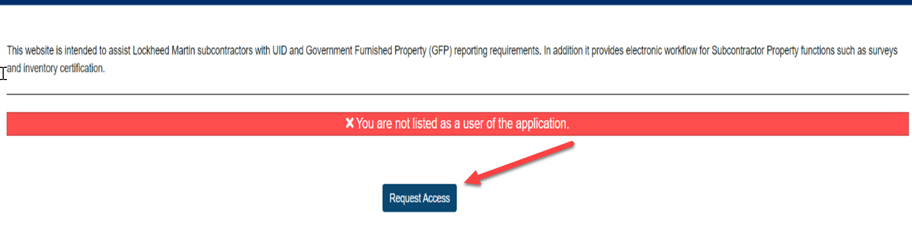
Accessing the Subcontract Management Portal
OR

Slide 7
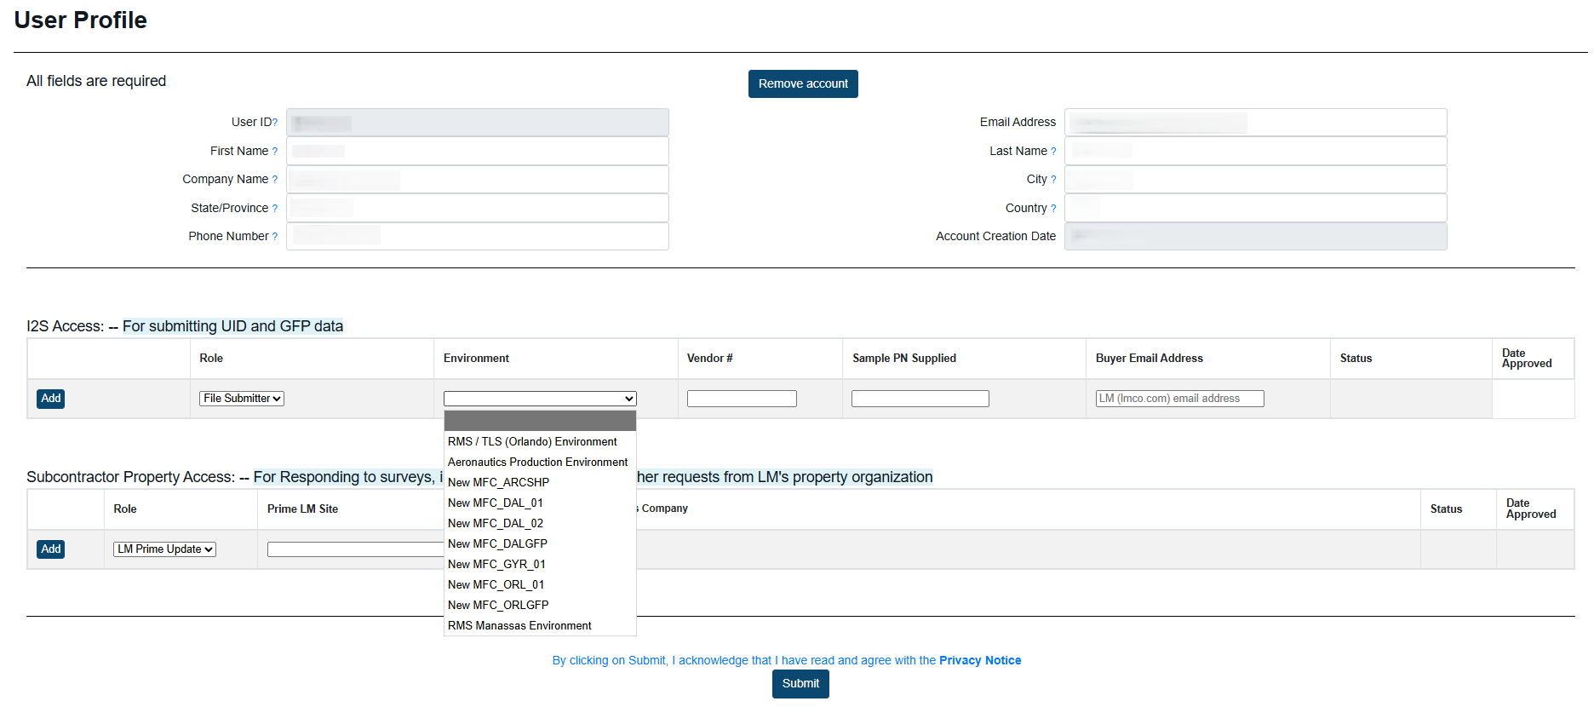
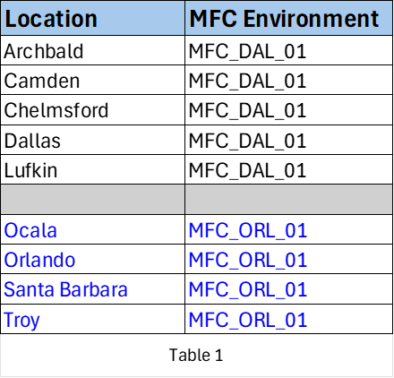
New User
To request an account, click the Request Access button from the Log in page, fill out all required data in the New User Access Request Form, and click Submit. Note for MFC Environments: Select the Environment based on the PO delivery location (see Table 1).
The request will be forwarded to an LM administrator for review and approval, and the Supplier will be notified when access has been approved

Slide 8
New User cont.
Select ‘File Submitter’ for the role
Select ‘Aeronautics Production Environment’ for the Environment for Aero.
Select ‘MFC_DAL_01’ or ‘MFC_ORL_01” for the Environment for MFC.
Select the applicable MFC Environment based on PO delivery location (see Table 1).
Enter the company Duns # for Vendor#
Enter a part number from a current open PO for Sample PN
Enter the email buyer’s email address
Example for Aero below:

Slide 9
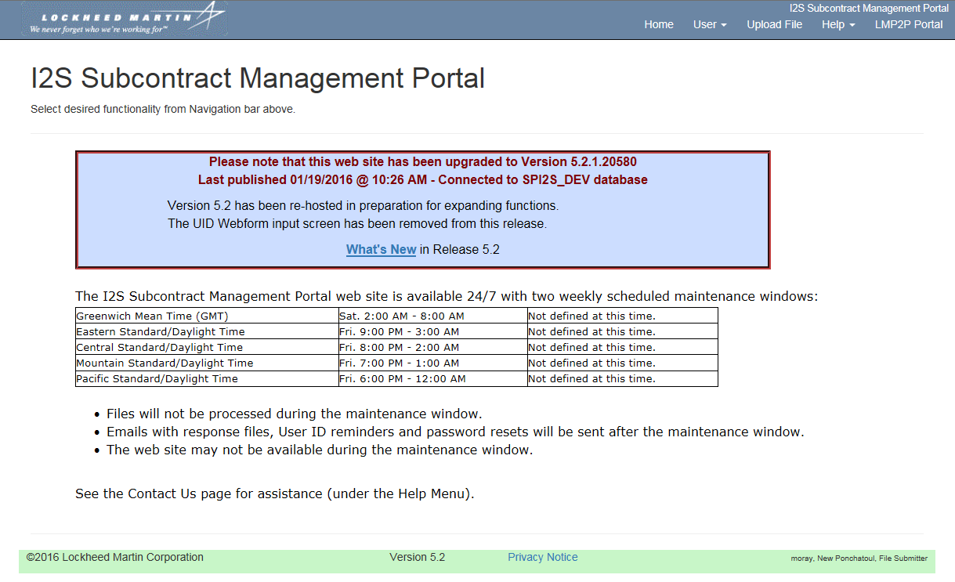
Home Page
The Home page displays the system’s weekly maintenance windows
Use the navigation menu to access various functionality

Slide 10
Creating the UID File
Utilize the below template to create UID file (Instructions are embedded in the template)

Slide 11
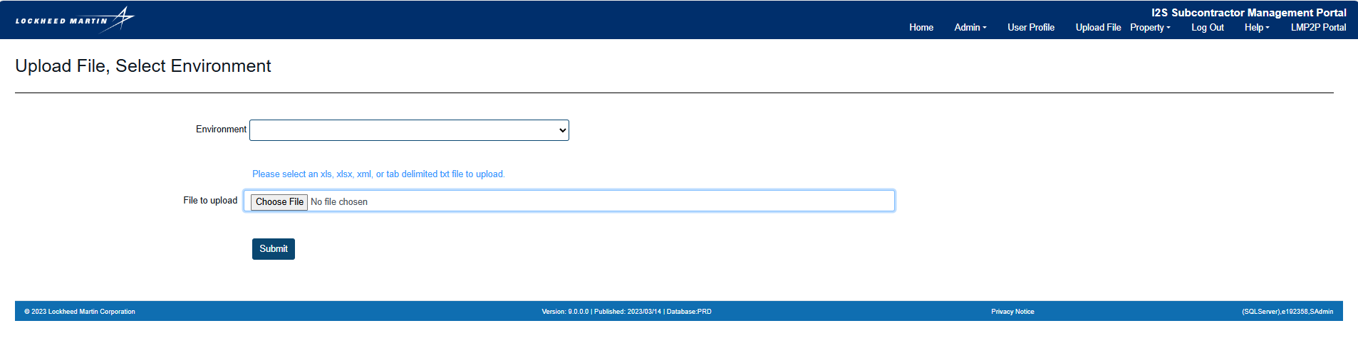
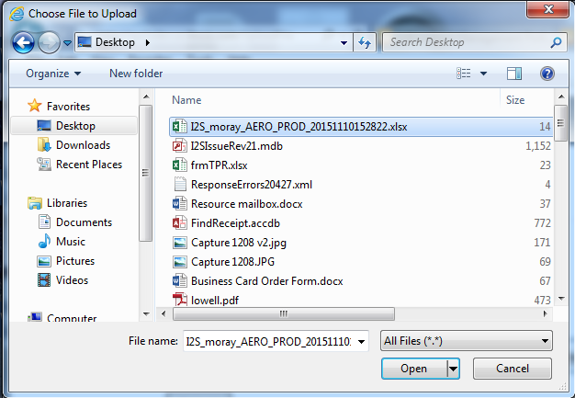
Uploading a File
After logging in, navigate to the appropriate environment and navigate to the Upload File menu option:
Click the Choose File button; on the pop-up window, browse for and select the file to be uploaded:
Files are accepted in the following formats:
Excel (.xls or .xlsx)
tab-delimited Text (.txt)
XML (.xml)

Slide 12
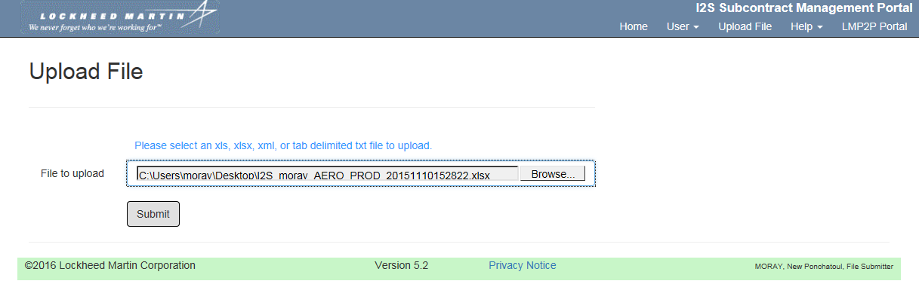
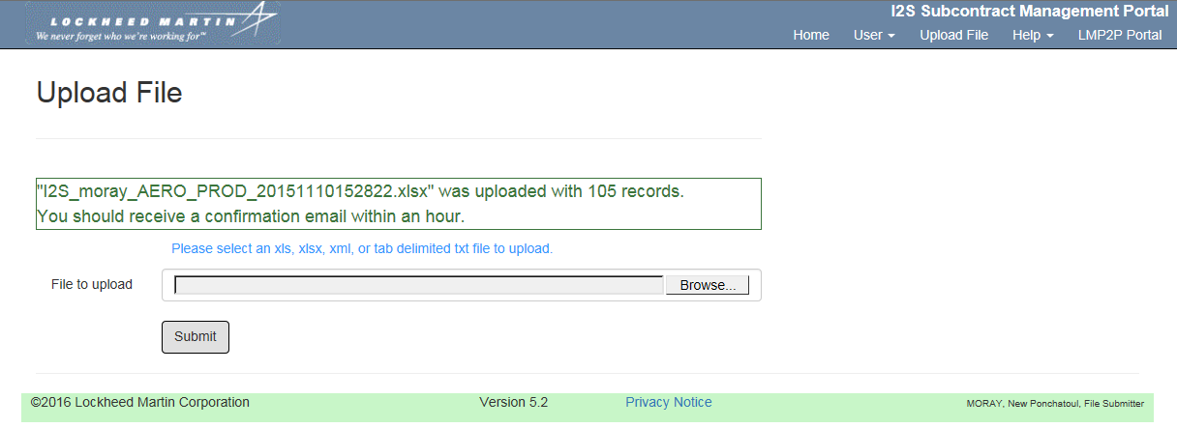
Uploading a File
Once the file is displayed in the dialog box, click Submit
A confirmation message displays:
You will then receive an email within the hour with the results of your transactions, including any errors

Slide 13
For support, please contact
Aero: supplier-integration.gr-aero@lmco.com
MFC: Supplier.Onboarding.1LMX@lmco.com

